Slide 1

Have you ever wondered what if you can track the status of a queue near a shop during these pandemic situation using an app? So Here we are presenting you “ TECH INNOVATOR’S CROWD ALERT SYSTEM ”

Slide 2
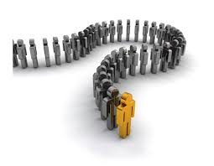
One day, my mom has sent me to buy groceries so I went to a shop which is 3 km away from my home.
As soon as I reached the shop I found a heavy crowd waiting in a queue and one of the security has informed me that I should come tomorrow because shops will be closed 1’ o clock during lock down as per government rules.
So I went back and the next day I have same situation and finally hardly before the shop gets closed I bought the groceries.
And this gave me an idea why can’t we design an app which gives status of the crowd near a shop . While customers can easily monitor from home and when crowd count decrease they can go and buy the products. This gave a idea for this project.

Slide 3

VISION OF OUR PRODUCT
Our product vision is to provide current status and live update of a crew near a shop and enable social distancing to fight against COVID-19 and secure our health.

Slide 4
PROBLEM & CURRENT SOLUTIONS:
On considering today’s situation, it is very essential to secure our health from novel corona virus(COVID-19)
But as we consider our country the population is about 1,369.56 millions not every body follows such guide lines . Some follow , some violate.
By at least maintaining social distancing plays a key role in fight against COVID-19.
The existing crowd alert systems just intimate crowd when there is a any natural disasters and other aspects . Some of the existing systems are Global Disaster Alert and coordination System (GDACS) which gives alert during earthquakes , Crowd Alert by hack Delhi provides information about current number of people in particular coach and/or bus.
But our system completely provide the status of the crowd near the shop where customers can track the data and decide where they will decide which shop they should go where the crowd is less.

Slide 5
OUR PROPOSED SYSTEM:
As I mentioned already our mission is to achieve social distancing and fight against COVID-19
We have developed a IOT based application which gives the current status of a crowd near a shop
Working : We have splitter our app in to seven different screens the function as follows:
In the first screen, by clicking get started button , user will be able move to next screen.
Screen 2 is a login page where we have set up different login ids and passwords and each user and shop owners will be provided with login id and password .
If any user wanted to register by clicking signup button it will take you to the other screen where he can sign up by entering the user first name, last name , mail id, phone number. In this screen we have three buttons add account, send data, sign up.
By clicking on Add account, the data which is entered , mail id and mobile number will be sent to the fire base console.

Slide 6
FLOW DIAGRAM OF THE PRODUCT
HOME PAGE
DATA TRANSFERRING
TO FIRE BASE CONSOLE
LOGIN SCREEN/SIGN UP SCREEN
FIRE BASE
CONSOLE
DATA STORING
[STORE VALUE AND GET VALUE]
Transferring of
data
TINY WEB URL
STORES LIST AND GUIDELINES FOR COVID-19

Slide 7
And by clicking sign up , the user will be directed to another screen where he/she will be provided with login id and password And this process is entirely for login. After login user will be directed to screen 3
Screen 3 consists of a label and next to it store in which customers can store the list of items which they should buy in the shop (this is provided for additional use) and By clicking →CREW COUNT it will automatically Direct the user to tiny web URL in which there are two cases as follows:
(1)In case of customer he have to click get value this will show the user how much crowd is near the shop
(2)In store value shop keeper has to manually enter the estimated count of crowd in the tag and value in the place of tag he has to store his shop name and value he has to store count By this he has enter the data manually every 5 min or 10 min or his wish how he can enter the data so that customers can track the crew count by just clicking the get value
And by just clicking→ STORES LIST it will automatically Direct to other screen were customers can see the list of shops in that area/town
By clicking GUIDELINES LINES FOR COVID 19 → Safety precautions

Slide 8
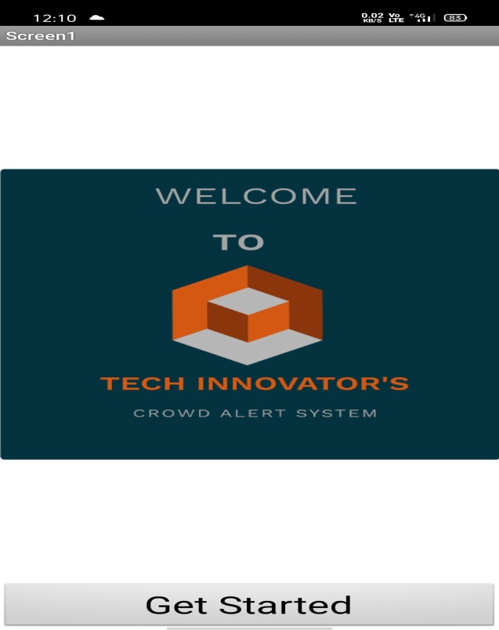
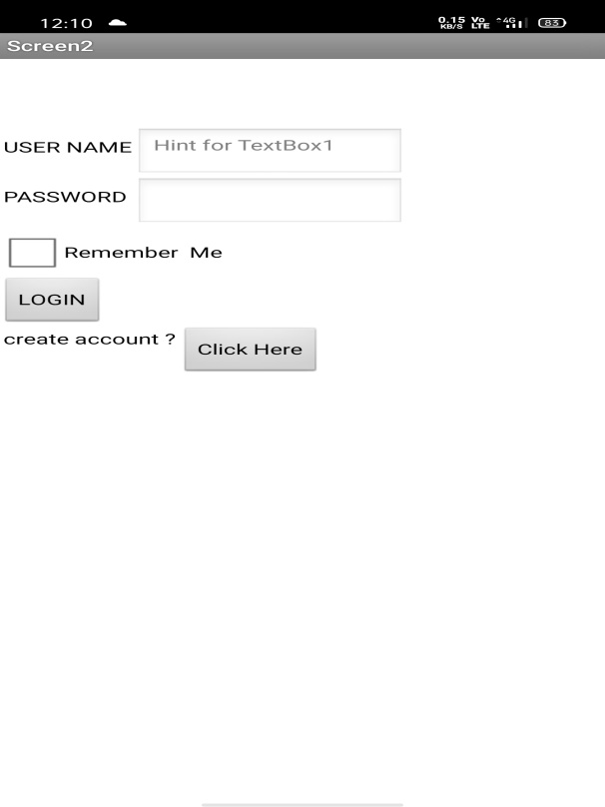
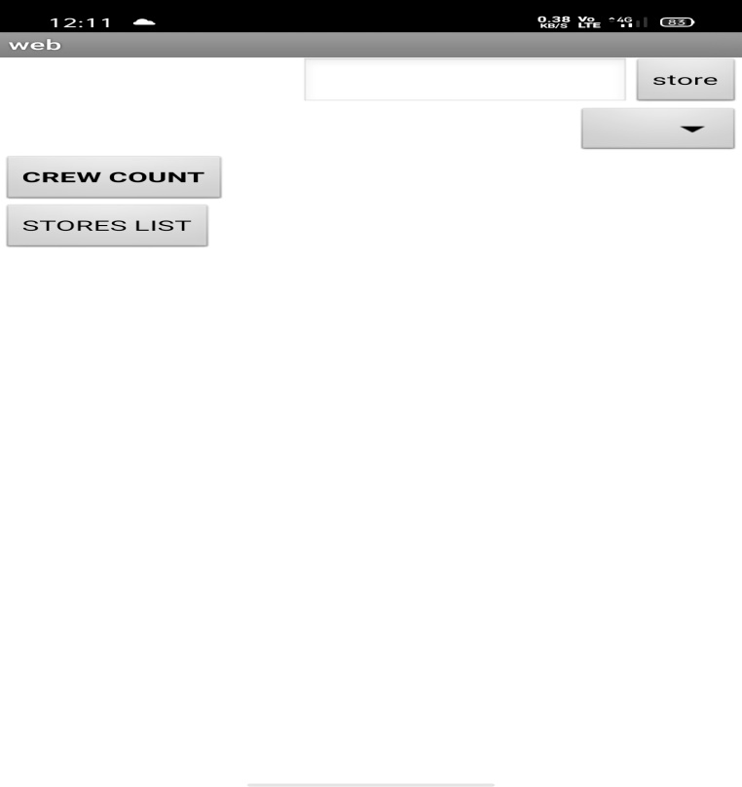
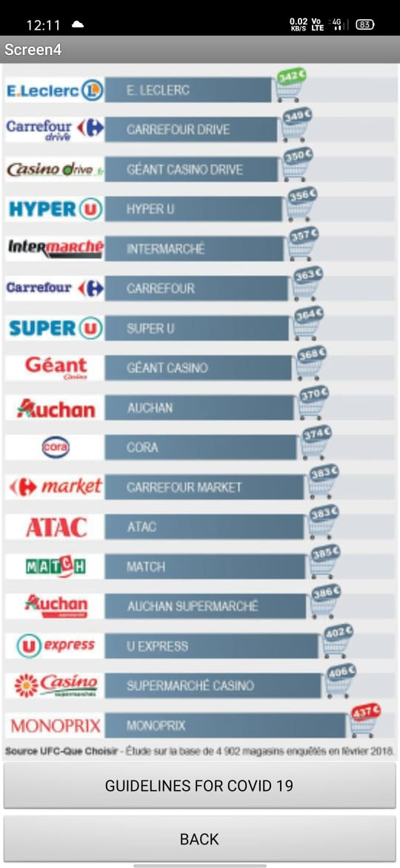
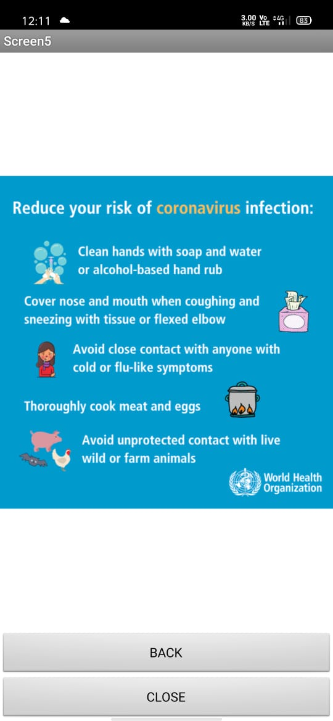
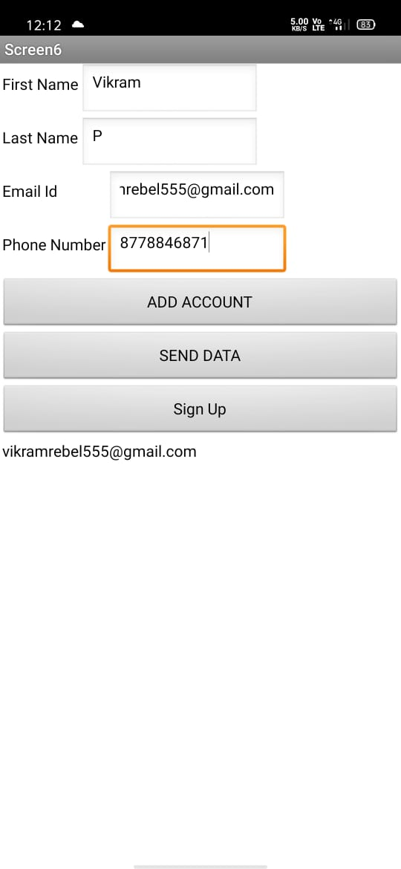

Slide 9
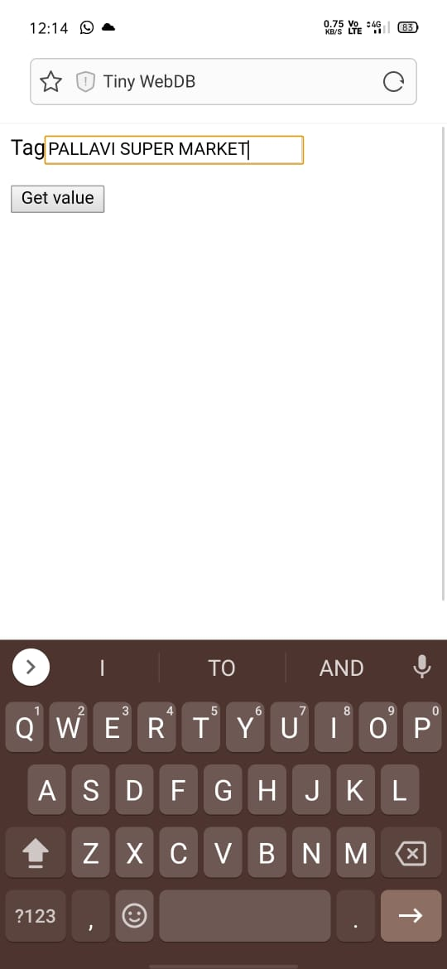
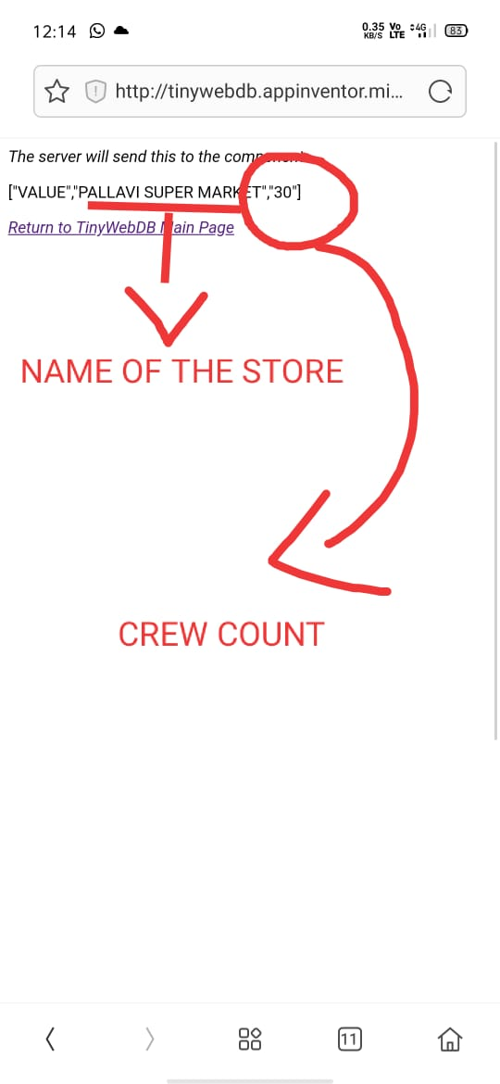
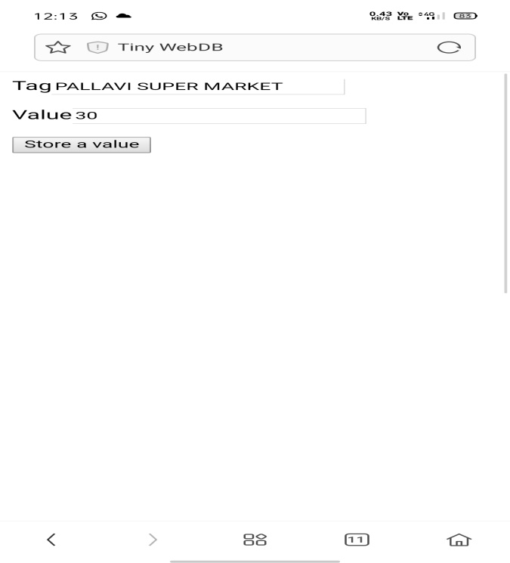
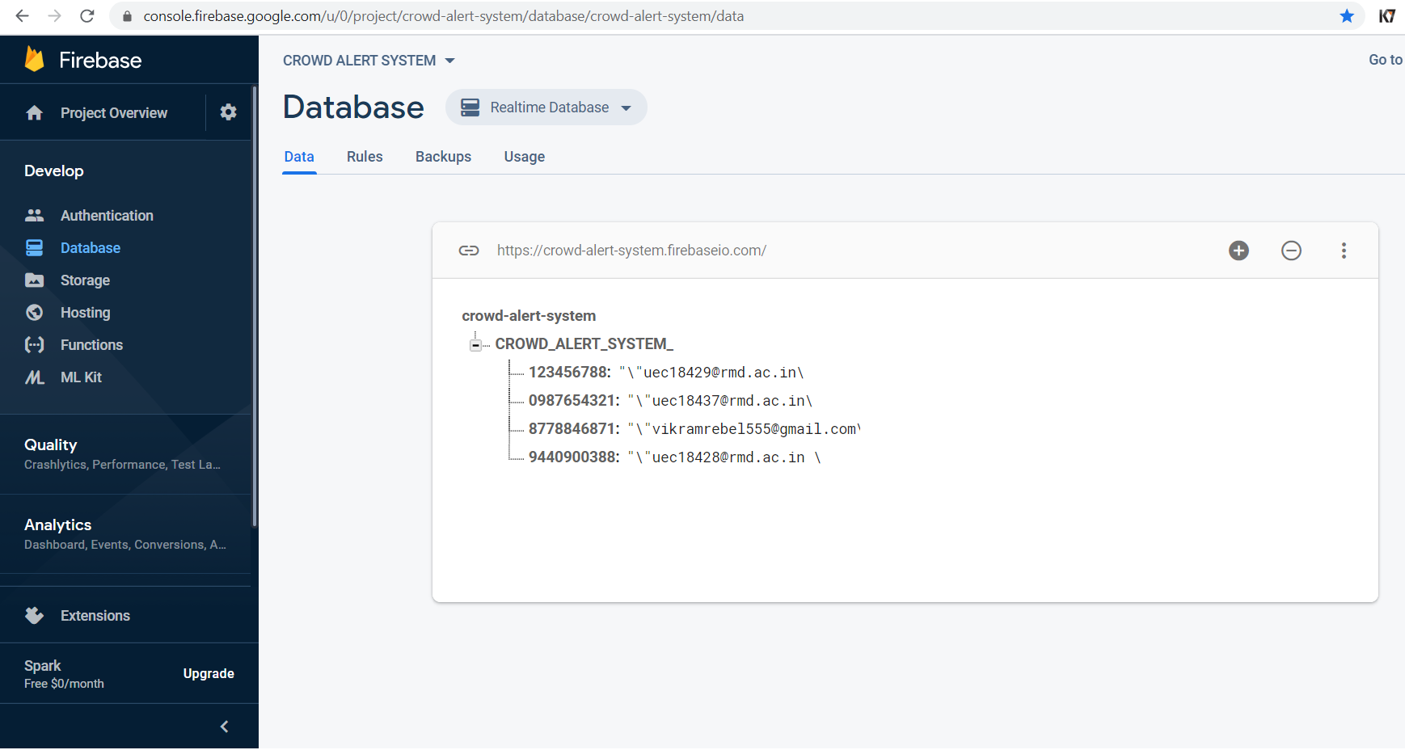

Slide 10
MARKET OPPORTUNITY:
To make our product with stand in the market
We have designed our in such a way that it is user friendly and ease of use and no complexity while using the app.
While considering the fact of customer base, every one in a particular Area/City/Town can use our product.
SWOT ANALYSIS:
STRENGTH: User friendly Ease of use Cost reduction Public interest | WEAKNESS: Network issues Sedentary lifestyle Privacy
OPPUTUNITIES: Infrastructure management Shopping complexes Super markets Even in case of health sectors as well | THREATS: Data theft Technology failure Strong competition

Slide 11
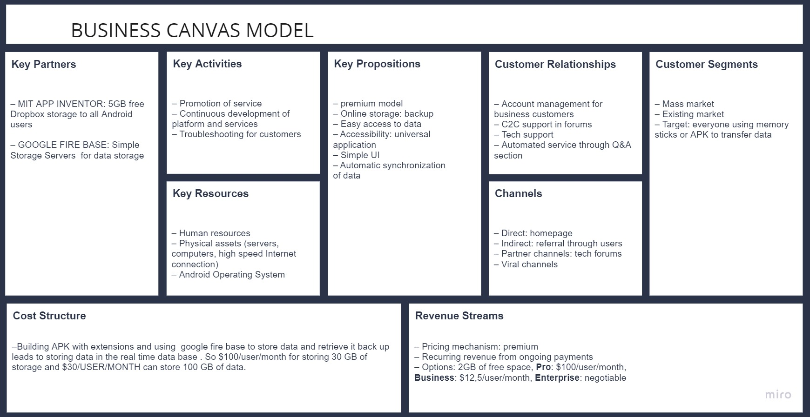

Slide 12
Market Approach & Strategy:
Life long free update of system
(*will still require subscription)
Provide customer a freedom life
Advertise through social media(Facebook , Instagram , Twitter …) and other e commerce sites
TARGET: Old aged people Middle class house holds Domestic uses Students | CHANNEL: Market place Partner’s channel E-commerce

Slide 13
COMPETITION:
As we started researching about the existing systems we have found that existing systems only provide crowd status in the buses/AC coaches and trains in order to know the how many members are actually present inside the vehicle.
In other cases existing systems provides an alarm before any kind of natural disasters or in case of security emergencies as well
Where as our product provide the current status of the crew near a store in a locality (ie) it is not like as others .
Some of the competitors are:
Global Disaster Alert and Coordination System(GDACS)
Crowd Alert by hack Delhi
A Mobile based crowd alert system by IJARCCE (Egypt) still in developmental stage

Slide 14
TEAM DETAILS:
TEAM LEAD:
Vikram.P
TEAM MEMBERS :
(1)Tirumalasetty Dharani krishna
(2)WALAZAPET CHANDRAMANOJ
(3)Vemana Sai Sivesh
(4) SHREE NIKETHAN

Slide 15
INVESTMENT:
Our product is an application so it will be a low economic one.
For subscription for Google fire base for the functioning of transferring data from APK to cloud We require life time access. We strongly recommend Blaze plan as it store data of 10GB for real time data base. So it will be fine by funding $100 per month for storing 21 GB and by paying $90 we can send data up to 90 GB.
Apart from these Maintenance cost of $100 /6 months for app for back up and adding extensions would be fine for working for app with out any distortion.

Slide 16


